Slide 1
Final Project Epsilon AI
Name: Mohamed Hamdy Hassan
Project Name: Used cars dataset

Slide 2
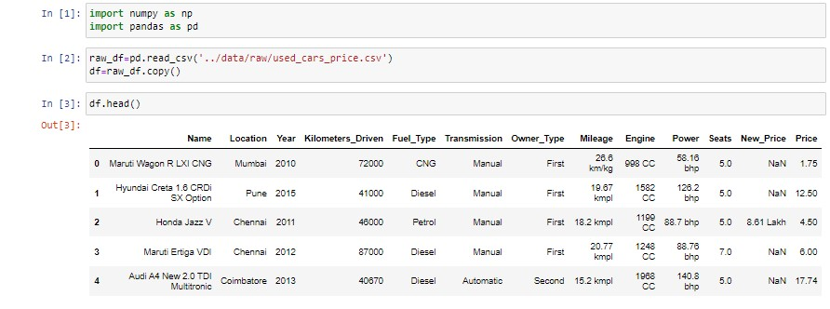
Purpose: A dataset containing all the required fields to build AI/ML models to find the price.
Description:
6019 records of used cars dataset, containing's :
- Name
- Location
- Year
- Kilometers_Driven
- Fuel_Type
- Transmission
- Owner_Type
- Mileage
- Engine
- Power
- Seats
- New_Price
- Price

Slide 3
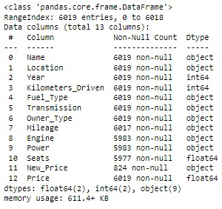
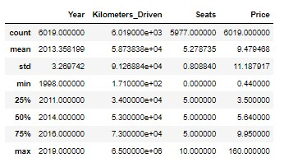
EDA (Exploratory Data Analysis): - Shape (6019,13) -->(5872,19) - Info - Statistics - Data Cleaning

Slide 4
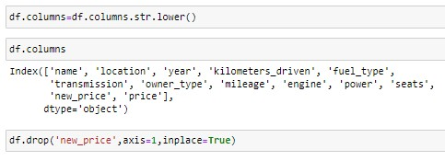
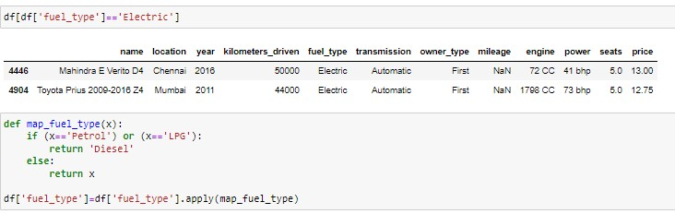
Data Cleaning: 1) Rename the columns. 2) Correction the datatype. 3) Deleting redundant columns 4) Cleaning individual columns

Slide 5
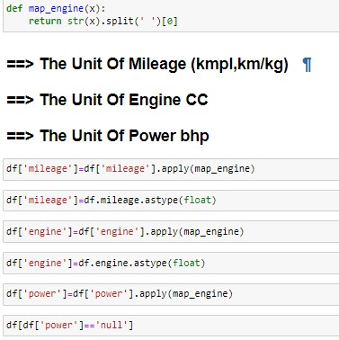
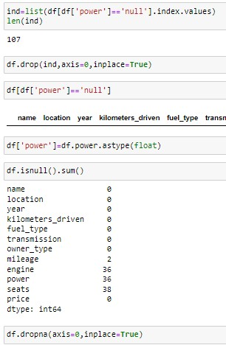
3) I standardized the measurements and split their unit

Slide 6
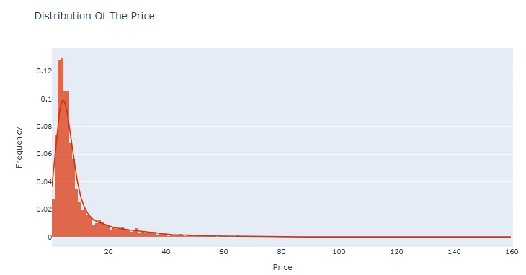
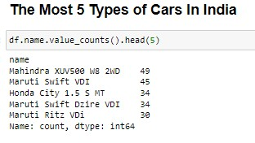
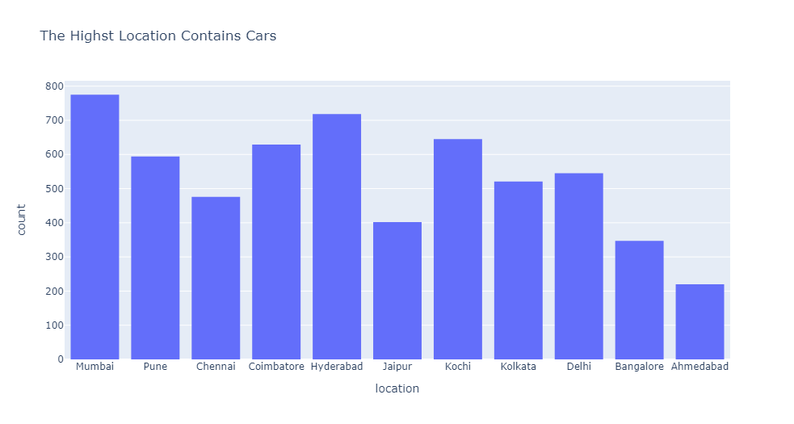
Data Analysis:
Questions:
1) The Distribution of Price ?
2) What is the highest types of cars ?
3) What is the highest locations contain cars?

Slide 7
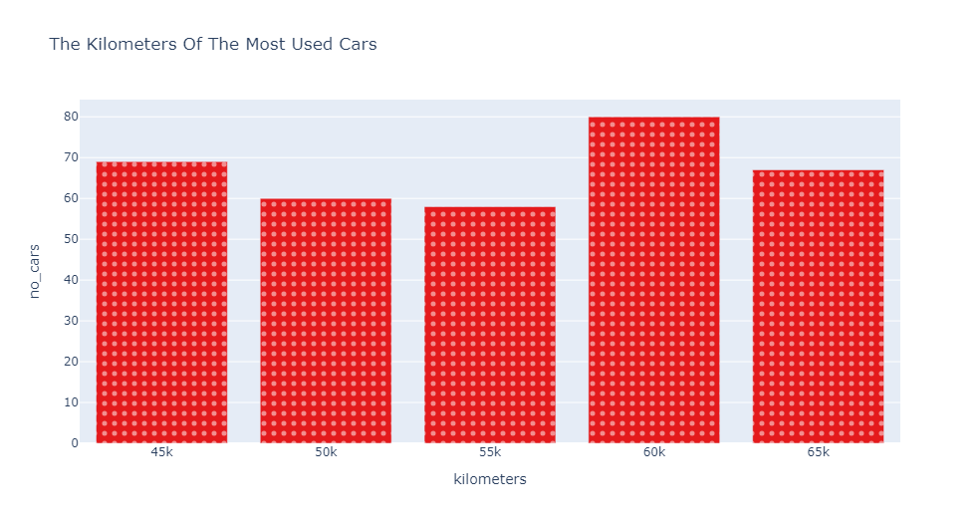
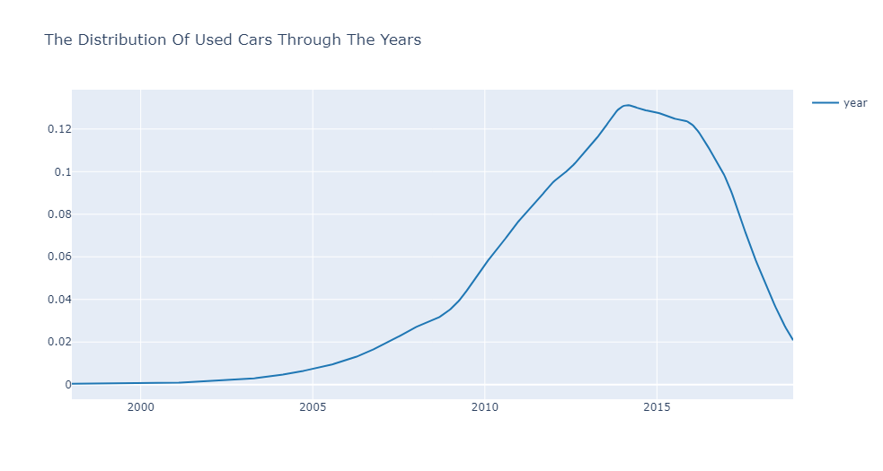
4) What is the highest year with cars ? 5) What is the kilometers of the most cars ??

Slide 8
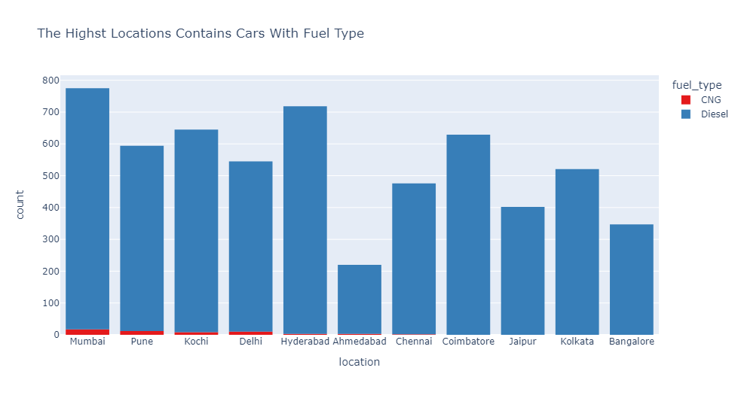
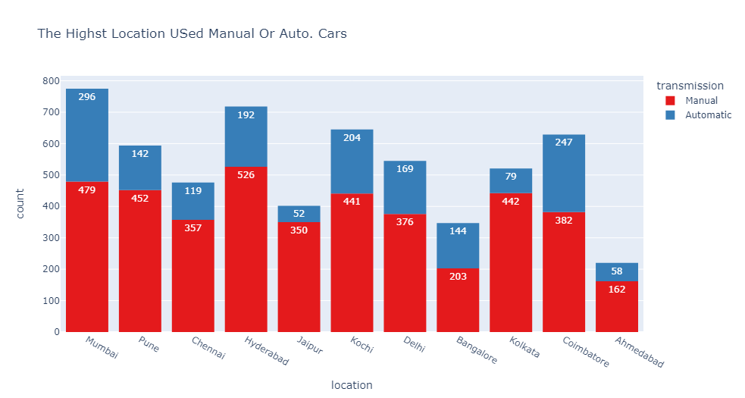
6) What is the highest fuel type of cars ? 7) What is the highest transmission of cars ?

Slide 9
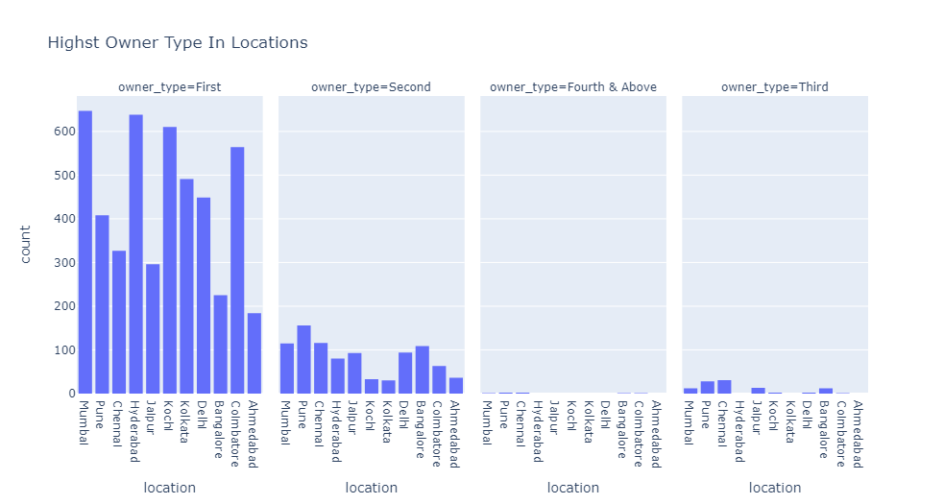
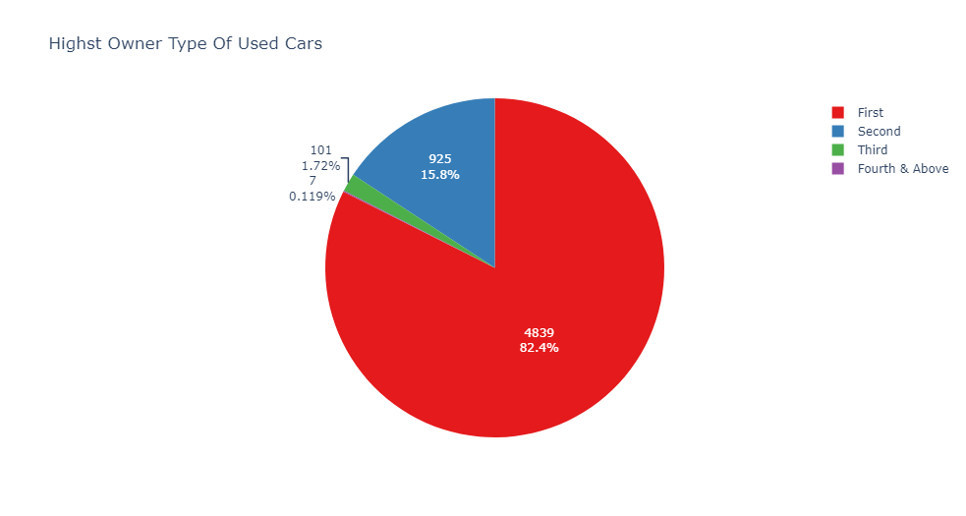
8) What is the highest owner type of cars ?? 9) What is the highest location with owner types ?

Slide 10
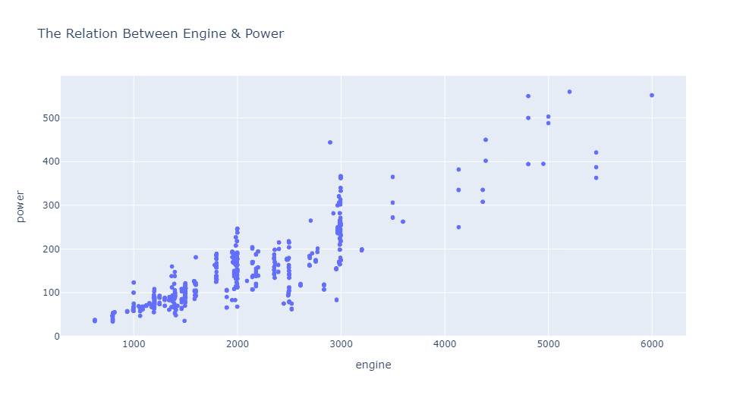
10) What is the relation between engine & power ?

Slide 11
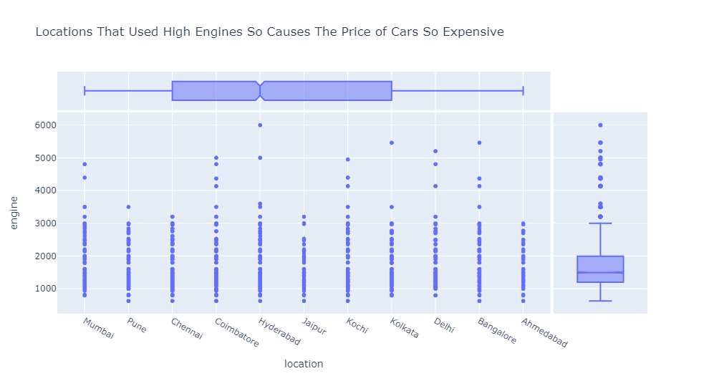
11) What is the distribution of power through years ?

Slide 12
Insights :
There is a positive relationship between the target(Price) and (engine,power,year).
The most 5 types of used cars:
- Mahindra XUV500 W8 2WD
- Maruti Swift VDI
- Honda City 1.5 S MT
- Maruti Swift Dzire VDI
- Maruti Ritz VDi
3) The most 5 locations that contain cars:
- Mumbai
- Hyderabad
- Kochi
- Coimbatore
- Pune
4) The Highest year with used cars is 2014 followed by 2015 and the cars decrease after that because of the increasing of price of the cars.
5) The Most of cars their kilometers are 60000KM.
6) The weight of fuel type of cars with manual transmission is 99.03% diesel and 0.94% CNG and the Automatic is 100% diesel.
7) The Highest location with Manual transmission is (Hyderabad) other wise the highest location with Automatic transmission is (Mumbai).
8) The kilometers of cars with Manual transmission are higher than Automatic transmission.
9) The Highest weight of owner type is first with(82.4%) followed by second(15.75%) and third(1.7%).
10) The Highest location with first owner type is Mumbai followed by Hyderabad and the highest location with second owner type is pune followed by Chennai.
11) We found the increasing of engines of cars through the years.
12) The relation between engine and power is linear.
13) The Highest cars with kilometers are with 5 seats followed by 7.
14) The price of cars increase through the years and the more the engine or power increases, the more the price increases.
15) The expensive cars are with 2 seats followed by 4 seats.

